Slide 1
Translation features of new biased lexical units of modern discourse
Master’s degree thesis
Zhurbenko K. O., PR.m-01

Slide 2
Goal of the study – to study the linguistic, translation and educational aspects of new biased vocabulary.
Tasks of the study:
consider the theoretical foundations of the concept of “neologism”, “slang”, “euphemism”;
define the concepts of “neologism” and “social neologism”, compare them;
define the concept of “slang”;
to distinguish between the concepts of “neologism” and “slang”;
describe the phenomenon of new biased vocabulary;
explore the concept of “negative connotation”;
analyze the translation of selected lexical items and conditionally group them;
create a set of exercises for learning to translate biased lexical items.

Slide 3
The object of the study – social neologisms and slang of modern English-language discourse, which can be biased.
The subject of the study – translation features and methods of teaching translation of social neologisms and slang of modern English discourse.
The material of the study – a sample of terms and concepts that define the social characteristics of a person, group of people and the mood of society.

Slide 4
Methods of the study:
    the method of induction
    the method of deduction
    the comparative method
    the method of continuous sampling
    methods of analysis

Slide 5
New biased lexis
a set of lexical units that are biased and cause ambiguous (including negative) attitudes among people

Slide 6
01
New biased lexis
02
Social neologisms
Slang

Slide 7
Neologism – word or phrase specially created for the name of a particular subject or expression of a new concept, linguistic innovation, individual lexical unit in its form and meaning or new, derived or not derived from the previous, meaning of a language unit added to an existing one that was not fixed dictionaries, which arises for communication, communicative acts, and is perceived by society as new for a certain period of time
Neologism – a new word or a phrase (general definition)
(by Yu. Zatsnyi)

Slide 8
Criteria:
Types:
indicates a new reality;
has a sense of semantic novelty;
adds a new, connotative shade to a word;
is fixed or unfixed in dictionaries;
exists at a certain point in time in a particular language space.
actual (colloquial) neologisms
authorial (stylistic) neologisms or occasionalisms

Slide 9
Social neologism
a subtype of neologism;
a new word, which denotes the concept of social character, gives a name to new features of a person, terms that denote certain features of a person as an individual or society as a group of people, phenomena that characterize the phenomena and concepts associated with society.

Slide 10
Slang
a set of lexical units, words or expressions used by certain groups of people united by a common feature (profession, age, etc.)

Slide 11
The difference between slang and social neologism
Difference –
the potential of acceptance as a common language unit
Both
are parts of
non-common language
are limited
in use

Slide 12
Negative connotation
an additional negative coloring of the meaning of the word, which gives a certain expressiveness and expresses the opinion of the speaker.
Such units may include offensive words (slurs), social neologisms, slang, which describe a person by his racial, sexual, religious or sexual orientation and other.

Slide 13
Main ways of translation transcription transliteration loan translation

Slide 14
ableism – ейблізм ageism – ейджизм youngism – янгізм oldism – олдизм cissexism – циссексизм colorism – колоризм lookism – лукізм heightism – хайтизм sizeism – сайсизм fattism – фаттизм sexualism – сексуалізм casteism – кастизм speciesism – спесисізм
Translation of “isms”

Slide 15
Translation of labels
demi
grey
pan
other prefix
Калькування зумовлене наявністю в українській мові категорією роду
sexual
romantic
демі
грей
пан
інший префікс
сексуал
романтик
(+ ка)

Slide 16
Additional ways of translation are modulation and descriptive translation.
For example, chubby chaser – поціновувач людей з формами.
Translation of slang – calque
bear – ведмідь, ведмедик
bear chaser – переслідувач, полювач на медведиків
chicken – курча
chicken hawk – хижак на курча, яструб
egg – яйце
fish – рибка
cub – щеня
otter – видра
fox – лисиця
wolf – вовк
unicorn – єдиноріг

Slide 17
Euphemisms as translation method
If there is a strong censorship, translator should translate biased lexical units neutrally, descriptively, and use euphemisms, if needed.

Slide 18
Methodology of teching
Social neologisms
Slang
as a common lexical material of a new topic
Social neologisms can be presented as lexical material in a socially oriented class
not included in Ukrainian education
Slang can be used as additional lexical material in a class

Slide 19
Set of exercises
Exercise 1.
Find and highlight social neologisms among the following words.
Define them.
Example: 1) ableism – discrimination in favour of the able-bodied;
ableism | communism | ecoterrorism | cissexism | chauvinism
casteism | albinism | catechism | algorism | sexualism
racism | socialism | anarchism | malapropism | heightism
feminism | dwarfism | fattism | sexualism | nepotism
alpinism | speciesism | gigantism | lyricism | activism

Slide 20
Exercise 3.
Match the types of sexual orientation with their definition.
1) heterosexuality | a) attraction rather to one’s high intelligence than to their sex or gender;
2) homosexuality | b) attraction to men or masculinity in people;
3) asexuality | c) attraction to people of the same sex or gender;
4) bisexuality | d) attraction to people regardless of their sex or gender;
5) demisexuality | e) attraction to women or femininity in people
6) gynesexuality | f) attraction to both men and women;
7) androsexuality | g) attraction to non-cisgender people exclusively;
8) pansexuality | h) attraction to people of an opposite sex or gender;
9) sapiosexuality | i) lack of attraction to people in an intimate way;
10) scoliosexuality | j) attraction to people for whom the subject has strong romantic feelings.

Slide 21
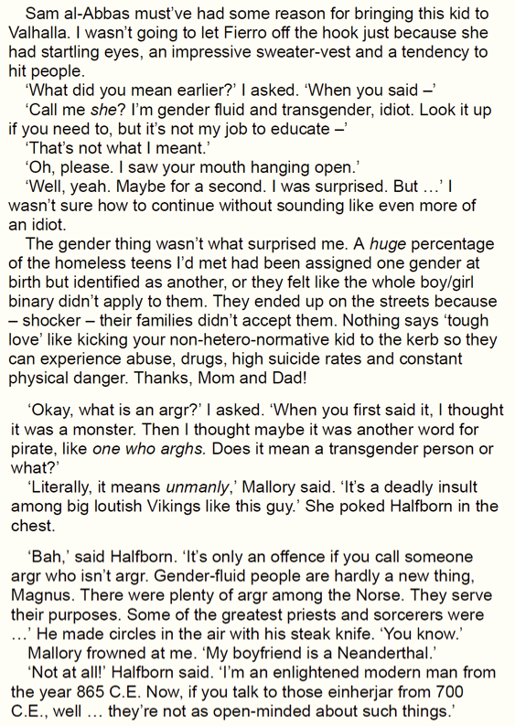
Exercise 5.
Perform a written literary translation of a book fragment.
Please note that the fragment can contain specific mythology notions or slang.
Exercise 6.
Group task (4 people). Prepare and hold an interview. Perform a consecutive translation.
Role-play: One person is a famous person in a sphere of choice (film industry, politics, activism or other), the second – an interview that likes to pose tricky questions, the other two – translators on each side.

Slide 22
General conclusions
a new biased lexis is a dimensional linguistic phenomenon that include neologisms, namely social neologisms, slang and its parts, including vulgarisms
the incessant process of replenishing the English language with words conditions the need of translation of these lexical units into the Ukrainian language
the connotation of biased units should be differentiated to neutral and negative, and translated according its semantics, lexical units can be neutralized, if needed
teaching neologisms is no different from teaching other lexical material
slang is not provided in the education program
teaching of translation of biased lexis should be approached from a neutral side, using euphemisms

Slide 23
Thank you for your attention!

