Slide 1
Euphemization and Dysphemization in Publicistic Discourse: Translation Aspect
Maria ikonopystseva, PRm-01
Iryna k. kobyakova, supervisor

Slide 2
Relevance: profound study of English euphemisms and dysphemisms, their linguistic nature and unified classification; methods of their translation into Ukrainian
Goal: analysis of euphemisms and dysphemisms peculiarities in the English publicistic discourse and methods of its translation into Ukrainian
Tasks:
1) analyze and generalize a set of theoretical issues;
2) determine the linguistic features of English euphemism and dysphemism;
3) outline the list of translation techniques for euphemisms and dysphemisms translation;
4) give examples of exercises for training students.

Slide 3
Object: English euphemisms and dysphemisms
Subject: linguistic features of euphemisms and dysphemisms and its translation into Ukrainian
Research material: English publicistic texts from world- known newspapers
Publication: article in the “Humanities Science Current Issues: Interuniversity Collection of Drohobych Ivan Franko State Pedagogical University Young Scientists Research Papers” (2021)

Slide 4
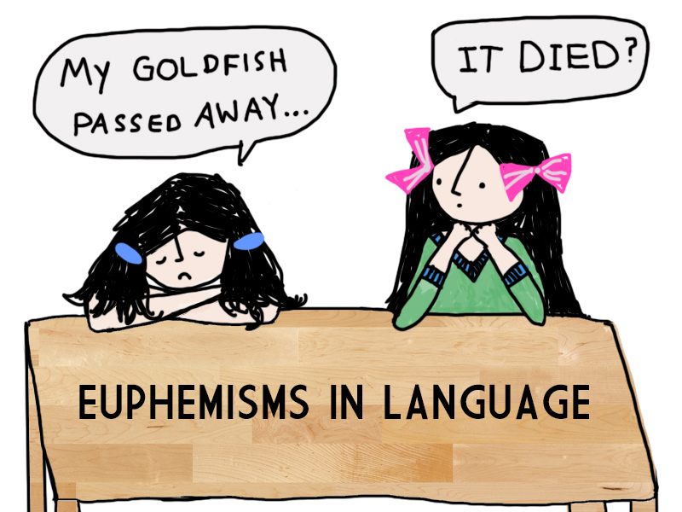
Euphemisms
units of secondary nomination with a relatively positive connotation, used to replace direct names, the use of which for socially or psychologically determined reasons is considered undesirable

Slide 5
Classification of euphemisms
notions of disease and death (to meet the Great Leveler, to meet the Lord, to breath one’s last, to be no more, to battle);
notions of evil, social crimes and related (send somebody to glory, three sheets in (to) the wind).
notions of poor social and economic state (be in Queer Street, to make the ends meet);
notions of mental illnesses and related (be off one’s nut, go nuts, weak in the head, a strange bird);
notions of physiological processes (a call of nature, in a (the) family way, not (without) a stitch to one’s back);
notions of sexuality (a lady of easy virtue, make whoopee, to bunk up, a house of ill fame, make love).

Slide 6
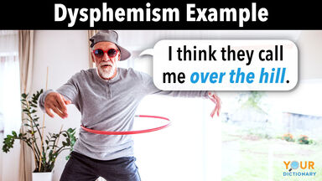
Dysphemisms
units of tabooed vocabulary intentional use or “words of low style”, as well as neutral lexical units that have a negative assessment, used to solve a certain communicative problem

Slide 7
Classification of dysphemisms
notions of the of death and disease (down with, raunchie, shot, hot short, Moby)
notions of physical and mental disabilities (looney, brain-sick, bats in the belfry, round the twist, shatter brained)
notions related to the criminal sphere (bilk, bilker, depredator, embezzler, ganef)
notions of defects in the character and behavior of people (plonk, zombi, drag, flat tire, forecastle lawyer)
notions of nationality (kange, rock candy, zigaboo, afro, boy, buffalo, buggy, clink)
notions of elements of religious rituals (archfiend, arch-traitor, arch-villain, Black Bogey, Clootie, Cloots)

Slide 8


Euphemisms and Dysphemisms Translation Aspect

Slide 9
Euphemisms translation in the publicistic texts
Equivalent translation:
Inmates paid $2 to ‘move deceased Covid patients to mobile overflow morgues’ as infections soar (Independent, Nov. 16, 2020).
У розпал епідемій пацієнтам пропонують оплату в 2 долари за переміщення померлих від ковіду до мобільних моргів.

Slide 10
Euphemisms translation in the publicistic texts
Omitting the euphemism:
Coronavirus: Damage from Covid-19 leaving lungs unrecognizable among deceased victims, says expert (Independent, Jun. 16, 2020)
Коронавірус: за словами експерта, у жертв ковід-19 легені були змінені до непізнаваності (переклад – М.І.)

Slide 11
Euphemisms translation in the publicistic texts
Interpretative translation:
Prominent conservative business executive passes away at 74 after enduring extensive battle with Covid-19
Відомий директор компанії програє виснажливу боротьбу проти ковід-19 у віці 74 років (переклад – М.І.)

Slide 12
Dysphemisms translation in the publicistic texts
Equivalent translation:
Putin, … has said he cannot forgive disloyalty and “traitors will kick the bucket” (Independent, Nov. 09, 2021)
Путін сказав, що він не може пробачити зраду і що «зрадники вріжуть дуба (переклад – М.І.)

Slide 13
Dysphemisms translation in the publicistic texts
Equivalent translation:
'Brutal' August gives way to hopeful September at Sarasota Memorial as COVID admissions drop (Herald-Tribune, Sep. 10, 2021
«Звірячий» серпень поступається великонадійному вересню, адже рівень госпіталізації з ковідом падає в лікарні Сарасота Меморіал» (переклад – М.І.).

Slide 14
Dysphemisms translation in the publicistic texts
Construction substitution:
The coronavirus surge is taking an increasingly dire toll across the U.S. just as a vaccine appears close at hand (Independent, Nov. 20, 2020)
Спалах коронавірусу забирає все більше й більше життів по всій Америці попри всю доступність вакцинації»
(переклад – М.І.)

Slide 15
Practical recommendation for translation classes
Creating a personal vocabulary with politically correct terms and general equivalents;
Distinguishing euphemisms and dysphemisms within the texts of different discourses;
Stating the theme correspondence of the euphemical and dysphemical usage in the text given, etc.

Slide 16


