Slide 1
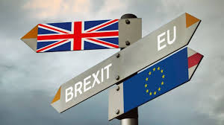
Brexit-discourse: Lexico-stylistic and Translation Aspects
Performed by|
Diana Nestorenko
Scientific supervisor|:
Professor.
Iryna Kobyakova

Slide 2
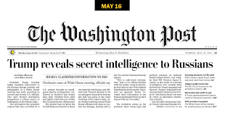
The purpose of the study is to investigate lexical, stylistic, and translation peculiarities of the Brexit discourse based on the texts of the newspaper “The Washington Post|”.
The subject matter of the study is the Brexit discourse. Its objectives are linguistic and stylistic markers of the analysed discourse, difficulties of its translation, and use of media material at foreign language classes.

Slide 3
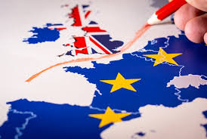
The Brexit discourse is the text deepened in the social and political situation whose characteristic features are communicative intentions of addressees (media texts’ authors) to influence the perception and comprehension of the event by recipients, negatively critical tonality of material relation, and specific patterns of verbalising notions.

Slide 4

We English are disappearing; we English are being engulfed by outsiders; we need to “Take Back Control,” as the Leave campaign slogan has it; we need to fight back against foreigners/regulations/globalization/modernity or whatever you personally find threatening
Hoping to cauterize the Conservative Party’s long-festering wound, in 2016, then-Prime Minister David Cameron succumbed to the plebiscitary temptation, scheduling the referendum that he believed Remain would win.
Both Ms. May and her parliamentary opponents must now make it their overriding priority to avoid that disastrous outcome (The Washington Post, 15.01.2019).
Prime Minister Boris Johnson had maintained that the five-week suspension was a routine break between parliamentary sessions ahead of the launch of a new legislative program (The Washington Post, 20.09.2019).
As expected, the opposition Labour leader, Jeremy Corbyn, has called for a vote of no confidence in the government (The Washington Post, 15.01.2019).
Meanwhile, two members of her cabinet resigned. One of them was clever, soft-spoken Dominic Raab, who had been the Brexit secretary (The Washington Post, 16.11.2018).
A statement by European Council President Donald Tusk said the rejected accord “remains the best and only way to ensure an orderly withdrawal (The Washington Post, 15.01.2019).
Remainers think Britain’s prosperity depends on its location. Leavers think its prosperity, long-term, depends upon its character
In the United Kingdom, supporters of Brexit promoted it as a statement of their country’s strength and independence. But it has achieved the opposite. It has weakened the bonds between our four “home” nations – England, Wales, Scotland and Northern Ireland – and raised again the prospect of the break-up of the United Kingdom

Slide 5

Newly built lexemes
By suffixation. Наприклад: The very Brexiters who promised a cakewalk are denouncing the result of their own policy (The Washington Post, 15.11.2018). If the deal is again voted down, it is highly likely that Parliament would reject the “no deal” position favored by Brexiteers the following day (The Washington Post, 11.03.2019);
By prefixation(anti-Brexit, pro-Brexit, post-Brexit). Наприклад: French customs officers are having a pre-Brexit strike at the Gare du Nord in Paris, delaying London-bound trains and demanding extra compensation (The Washington Post, 13.03.2019);
By compounding. Наприклад: Since the referendum in 2016, all of the key Brexit-negotiating jobs have been held by people who campaigned in favor of leaving the E.U. (The Washington Post, 13.03.2019);
By abbreviation. Наприклад: Preparations would extend beyond the Brexit deadline next March, so the European Union would have to agree to postpone B-Day

Slide 6
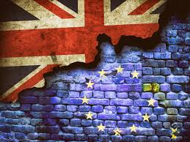
WORD GROUPS that denote
The very course of Britain’s leaving the EU and its esence (the entire Brexit process, the whole Brexit, the reality of Brexit, the Brexit vote, the Brexit solution, the Brexit example, the Brexit message, the Brexit deadline);
The destructive and crisis nature of the evnt (the Brexit crisis, a never-ending Brexit crisis, Brexit debacle, the inherent contradictions of Brexit, Britain’s Brexit agonies, the great Brexit drama, the least disruptive Brexit divorce from Brussels, the whole Brexit problem, a Brexit meltdown, the Brexit crackup);
Forms of expressing the will and taking decisions by voters and interaction of people (the state of Brexit talks, the Brexit negotiations, the Brexit referendum, the 2016 Brexit referendum campaign, the Brexit debate (the technical debates of Brexit, debate on Brexit));
Brexit’s participants from both sides (the Brexit camp, anti-Brexit
campaigners, the Brexit hard-liners, Brexit voters, pro-Brexit voters, the Brexit gang, the Brexit Taliban, Brexit ministers, the Brexit crowd, the Brexit purists, brave Brexit campaigners, Brexit negotiator, advocates of Brexit (the Brexit advocates), Brexit’s opponents, Brexit proponents, top Brexit standard-bearers);
Political forces (pro-Brexit Conservative backbenchers, the pro-Brexit UK Independence Party (UKIP) and Leave.EU);
agreement (Brexit deal, a Brexit formula, a Brexit accord, the Brexit plan, a no-deal Brexit, the final Brexit deal, Theresa May’s Brexit agreement, a negotiated Brexit deal, the 585-page Brexit agreement);
Consequences and prospects of the withdrawal (the post-Brexit future, the Brexit prospect, the effect of the Brexit prospect on Northern Ireland, post-Brexit Irish-Northern Ireland border, post-Brexit beauty contest, Brexit’s certain costs, Brexit victory).

Slide 7
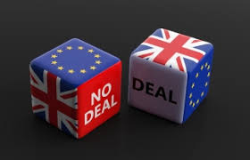
A choice between huge numbers of dead lambs and huge payouts to sheep farmers is just one example of the turmoil that a no-deal Brexit could bring. This week, which has been chaotic in British politics even by recent standards, has made that just a bit less likely. It is the week that Remainers invoked the horror of a no-deal Brexit to grab back some control over a Parliament still unable to decide what it wants
Because the emerging deal is a mess — a dog’s Brexit, the wags say — it may well be blocked in Parliament
So, of the 20 percent probability of a clear May win, only half — say, 10 percentage points — leads to a compromise Brexit, bringing the cumulative probability of this option to 30 percent
On Tuesday, the British Parliament rejected, again, Prime Minister Theresa May’s Brexit deal, an arrangement that would have given Britain a reasonably smooth transition period out of the European Union. It was a deal that pleased no one, but some saw it as a way out of a dilemma

Slide 8
Stylistic devices
Britain, famous for its prudence, propriety and punctuality, is suddenly looking like a banana republic as it makes reckless decisions, misrepresents reality and now wants to change its own self-imposed deadline
Older citizens, workers and people living outside the large cities are terrified of what they see as a German-dominated European juggernaut, and voted Out
They want the whole Brexit saga to end

Slide 9
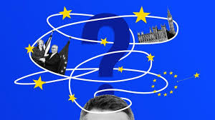
Irony
1) The latest outburst of (metaphorical) fisticuffs came on Thursday when a caucus of May’s pro-Brexit Conservative backbenchers announced a bid to oust her from the party’s leadership (The Washington Post, 16.11.2018).
(2) May, who tepidly opposed Brexit before the referendum, has found it nearly impossible to navigate around both the demands of Brexit cheerleaders and the vastly superior negotiating position of the E.U. (The Washington Post, 15.11.2018).
(3) Coupled with a sense that their country — much like themselves — has been disrespected and buffeted by ominous forces, the temptation is to indulge in conspiracy theories, blame outsiders and resort to political nihilism. Soon leaders don’t lead, hucksters emerge to play on fear and instantaneous social media intensifies public mood swings and propagates all sorts of myths. (Foreigners are stealing our jobs! Free trade is bad!)

Slide 10
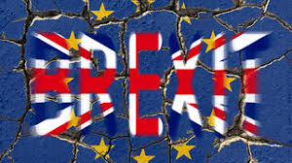

Slide 11
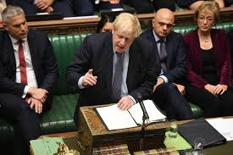

Slide 12
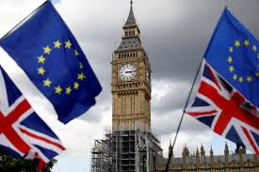
Meanwhile, the mother of Parliaments has gone mad, the governing Conservative Party shows contempt for business, and its Labour rival has been taken over by lovers of Karl Marx
It is time for Britain to leave the European Union — with or without a deal (The Washington Post, 30.01.2019). In other words, the U.K. stays inside Europe’s trading space until … whenever

Slide 13
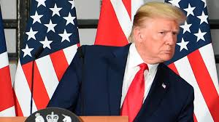
Finally, I do realize that it’s facile to talk about the impact on a U.S. election that is still many months away, that it’s too simple to say “first Brexit, then Donald Trump.” <…> If that kind of transformation can take place in the U.K., then it can happen in the United States, too. We have been warned (The Washington Post, 24.06.2016).
Brexit is a cautionary tale for Trump supporters (The Washington Post, 27.06.2016).

Slide 14
THE MAIN DIFFICULTIES OF TRANSLATING THE BREXIT DISCOURSE
nationally and culturally biased units, e.g. The threat of a hard Irish border had lingered over Brexit negotiations, with concerns that the violence of the Troubles could return if border checks between Northern Ireland and Ireland, which remains an E.U. member, are established (The Washington Post, Jan. 1, 2021). Загроза жорсткого ірландського кордону затримала переговори з Брекситу через занепокоєння, що може повернутися тридцятирічний збройний етнічно-політичний конфлікт, якщо буде встановлено контроль на кордоні між Північною Ірландією та Ірландією, що залишається членом ЄС. Переклад реалії the Troubles здійснюємо описово словосполученням тридцятирічний збройний етнічно-політичний конфлікт.
proper names, e.g. In fact, the way the UKSC approached this case suggests that it is aware of this possibility (The Washington Post, Sept. 20, 2019). Насправді, те, як Верховний суд Великої Британії підходить до цієї справи, свідчить про його усвідомлення такої можливості.

Slide 15
THE MAIN DIFFICULTIES OF TRANSLATING THE BREXIT DISCOURSE
noun clusters, e.g. Britain’s post-Brexit relationship with the E.U. – відносини Британії з ЄС після Брекситу, smaller “equivalence” deals – угоди нижчої вартості, British Prime Minister Boris Johnson’s “get Brexit done” mandate – мандат завершеного Брекситу Британського прем’єр-міністра Бориса Джонсона, swapping an “ever-closer union” for “what may be an ever-closer agreement” – замінюючи ще тісніший союз на можливо ще тіснішу угоду, to run a “people versus Parliament” campaign – розпочати кампанію народу проти парламенту
set expressions, e.g. He has purged Tory moderates, including two former chancellors and the grandson of Winston Churchill, and declared that he would “rather be dead in a ditch” than ask Brussels for a delay to Brexit (The Washington Post, Dec. 12, 2020). Він позбувся поміркованих Торі, включаючи двох колишніх канцлерів та онука Вінстона Черчилля, і зробив заяву, що краще «помре у злиднях», ніж попросить Брюссель відтермінувати Брексит.
headlines of the articles, e.g. Brexit and Trump: When politicians light xenophobic fires, everybody gets burned. Брексит та Трамп: Коли політики жартуватимуть зі ксенофобічним вогнем, самі обпечуться.

Slide 16
Ways of translation of the Brexit -discourse
transliteration, e.g. As a result, the Conservatives face electoral losses in areas that backed remain, such as the south and southwest, as well as Scotland, where popular Conservative leader Ruth Davidson has resigned. To win a majority in the next election, then, the Conservatives must consolidate the leave vote, neutralizing Nigel Farage’s new Brexit Party and winning towns in Labour strongholds in northern England that voted to leave the E.U. (The Washington Post, Sept. 18, 2019). Як результат, консерватори зіштовхуються з утратами електорату у тих районах, що підтримують ідею залишатися в ЄС, таких, як південь та південний захід, а також у Шотландії, де пішла у відставку популярна лідерка консерваторів Рут Девідсон. Для того, щоб потім завоювати більшість на наступних виборах, консерватори мусять консолідувати на виборах прибічників виходу, нейтралізувавши нову Партію Брекситу Найджела Фаража та завоювавши підтримку у містах, цитаделях лейбористів, у північній Англії, які голосували за вихід із ЄС.
loan translation, e.g. The new prime minister was able to get his withdrawal agreement through Parliament in January 2020, which resulted in the long-awaited “Brexit Day” on Jan. 31 – when Britain formally Brexited. … брекситувала
functional analogies, e.g. a dog’s Brexit – не Брексит, а свинство

Slide 17
Ways of translation of the Brexit -discourse
explication, e.g. So, demography, combined with a new understanding of Brexit’s certain costs and myriad uncertainties, could cause 2016’s big bang that began Brexit to end with a 2019 whimper of a referendum saying, “Oh, never mind.”
internal commentaries, e.g. Corbyn and Farage also get very different popularity ratings from Leavers and Remainers (The Washington Post, Jul. 23, 2019). Корбін та Фараж також отримали різні рейтинги популярності від ливерів, прибічників виходу, та його противників – ремейнерів.
and compensation, e.g. e.g. But with the mammoth legislation pushed through with little time for deliberation, and the country focused on the surging coronavirus pandemic, the convoluted saga ended with an air of anticlimax (The Washington Post, Jan. 1, 2021). Але в той час як проштовхували велетенські законопроєкти, не виділяючи часу на їх обговорення, а країна затамувала дихання через стрімке поширення пандемії коронавірусу, заплутана сага закінчилась в атмосфері розчарування.

Slide 18
Work with Media Texts at Foreign Language and Translation Classes
Linguistic competence
Sociolinguistic competence
MUTUAL UNDERSTANDING
COMMUNICATION IN A A GLOBALIZED SOCIETY

Slide 19
The results of the research
Studying the properties of the Brexit discourse gives the possibility to use its material in the educational process: while learning lexicology and stylistics and practical courses of English and translation.
The recommendations made as a result of this study have been implemented in two articles published in the scientific journals in 2019 and 2021.
Further study may lead to the attempts to analyse effective manipulation strategies and tactics of the Brexit discourse, to find out phraseological potential, the pragmatic and semantic load of proper names, headlines to the articles, and pictures to them. They may also consist in determining the means to denote the politicians’ role in the event and comparing crisis political media discourses of Great Britain and the USA and foregrounding the evaluation in them (positive, negative, neutral).

Slide 20
THANK YOU FOR YOUR ATTENTION!

