Slide 1
Racially marked words in fictional and publicistic discourse: translational aspects
Student Hanna Vernydub, PRm-01
Supervisor Dr. of Philology S. O. Shvachko

Slide 2
Relevance: study of linguistic features of English racially marked vocabulary, as well as features of its translation in the texts of journalistic and fiction discourses.
Goal: study of linguistic features of English-language racially marked words in the context of journalistic and artistic texts, as well as study of features of their translation into Ukrainian.
Tasks:
describe the main milestones in the development of ​​racial segregation idea and the stages of its introduction into the vocabulary of the English language;
determine the linguistic status of racially marked vocabulary in English vocabulary;
describe the characteristics of ethnicity markers on the materials of English journalistic and fiction discourses;
identify and provide effective translation techniques for the reproduction of racially marked words in the Ukrainian language;
give set out practical recommendations for the training of translators in the field of journalistic and literary translation with a focus on the analyzed layer of English vocabulary.

Slide 3
Object: English words of racial identification
Subject: linguistic features and translation aspects within publicistic and fiction discourses.
Research material: newspaper articles and a historical fiction novel
Publication: 2 articles in the “Transcarpathian Philological Studies” (2020) and “International Humanitarian University Herald. Philology” (2021) correspondently

Slide 4
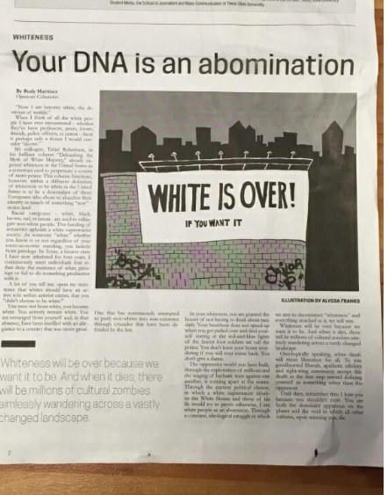
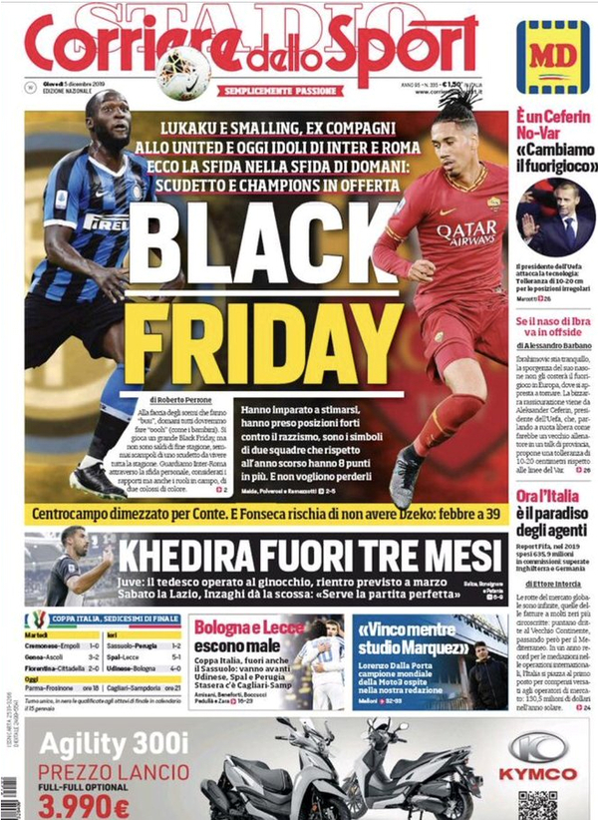
The term "xenophobia" comes from gr. “xénos” (foreigner) and “phóbos” (fear) are mostly understood as fear of strangers.
Racism is a form of xenophobia and is characterized by discriminatory attitudes and actions against certain races.

Slide 5
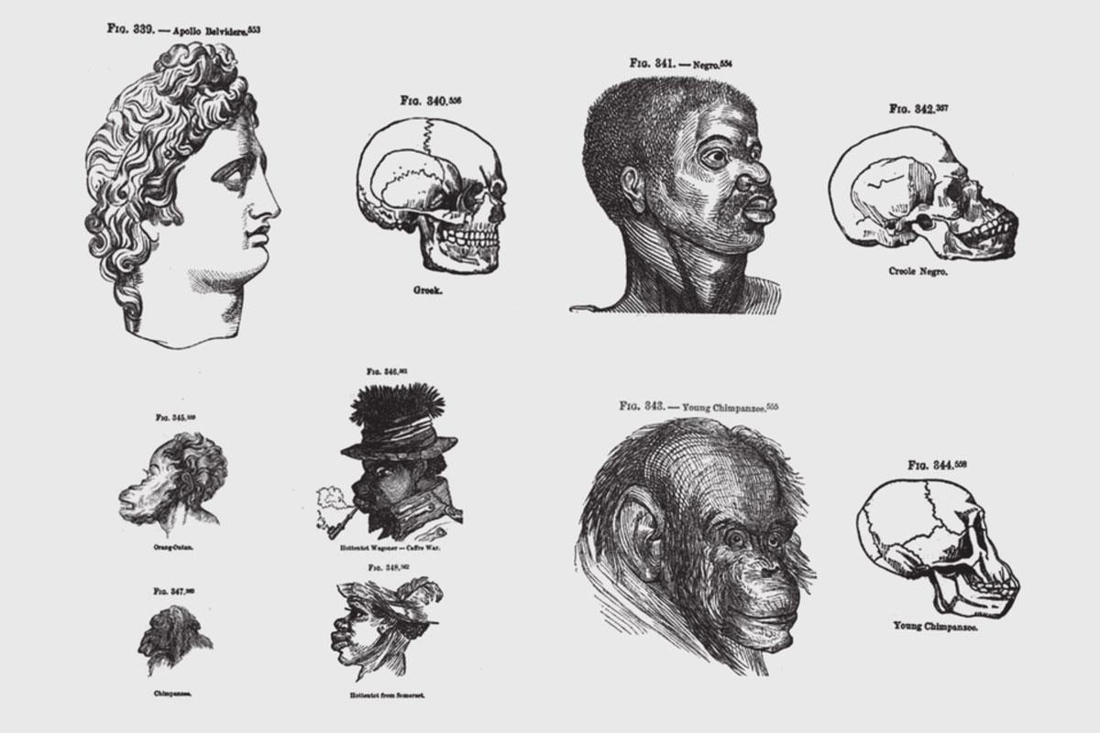
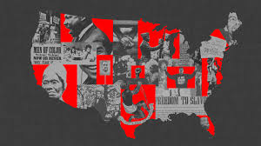
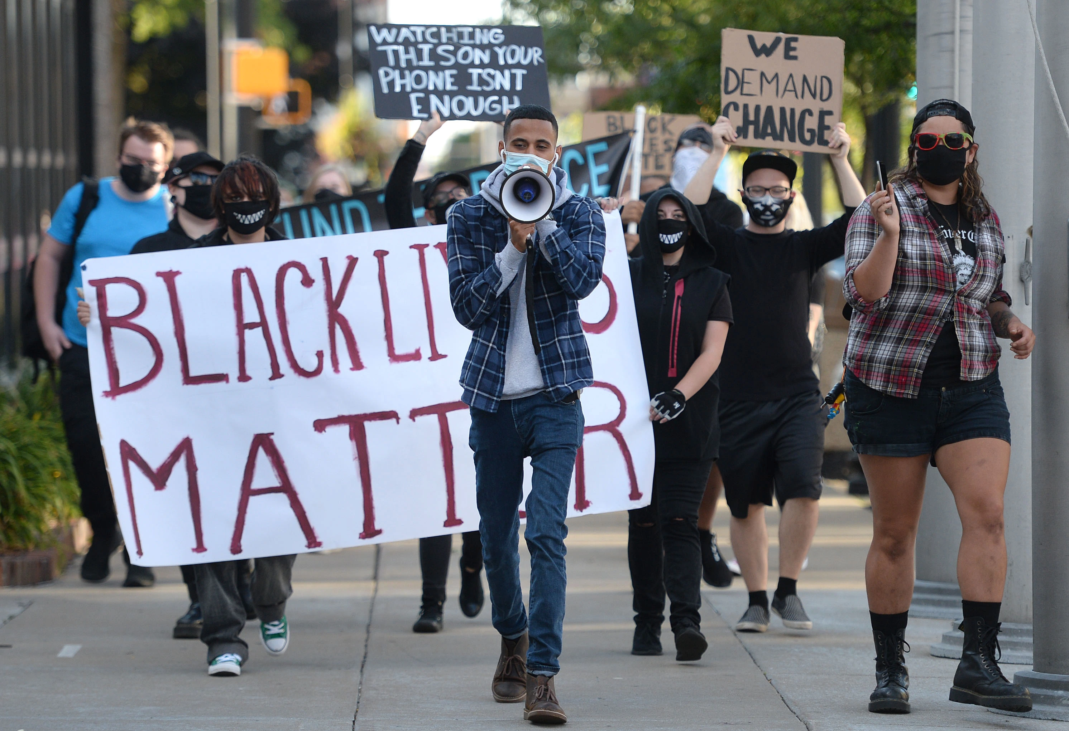
The ideas of racism in the English-speaking culture is closely related to the era of slavery and colonialism.
However, with disappearance of these phenomena, racist concepts have transformed, adapting to the circumstances and leaders of the modern world, passing into a state of covert, latent practices.

Slide 6
Lexico-semantic classification of racial identifiers in newspaper texts
Color of skin: Behind Willie Wilson's appeal to black voters: 'Willie’s story is the story of black people in America and black people in Chicago' (The Guardian, 2018, August 10)
Territory: A trademark dispute involving an Asian American band that calls itself the Slants provoked a lively Supreme Court argument … (Los Angeles Times, 2017, January 18);
Combination of color and territory: The killings of unarmed Black Americans have got to end,” Sanders tweeted” (The Washington Post, 2019, October 13)
Abusive words: ...referred to Latinos as “beaners” and blacks as “niggas” and “wild animals”… (The Washington Post, 2016, July 07)

Slide 7
Lexico-grammatical classification of racial identifiers in newspaper texts
One-component: ‘Beverly Hills while Black’: Race, wealth, policing collide on Rodeo Drive (Los Angeles Times, 2021, Novemver 30); The brouhaha over white nationalism and stories of Latino intimidation have overshadowed the fact … (The Guardian, 2016, December 12)
Two-component: Black households can afford just 25% of homes for sale, down from 39% in 2012 (USA Today, 2019, October 15); A trademark dispute involving an Asian American band that calls itself the Slants … (Los Angeles Times, 2017, January 18)
Three-component: Prominent Britons of colour condemn BBC over Naga Munchetty complaint (The Guardian, 2019, September 27); A wall that encaged me as a young, dark-skinned girl (Washington Post, 2019, August 07)

Slide 8
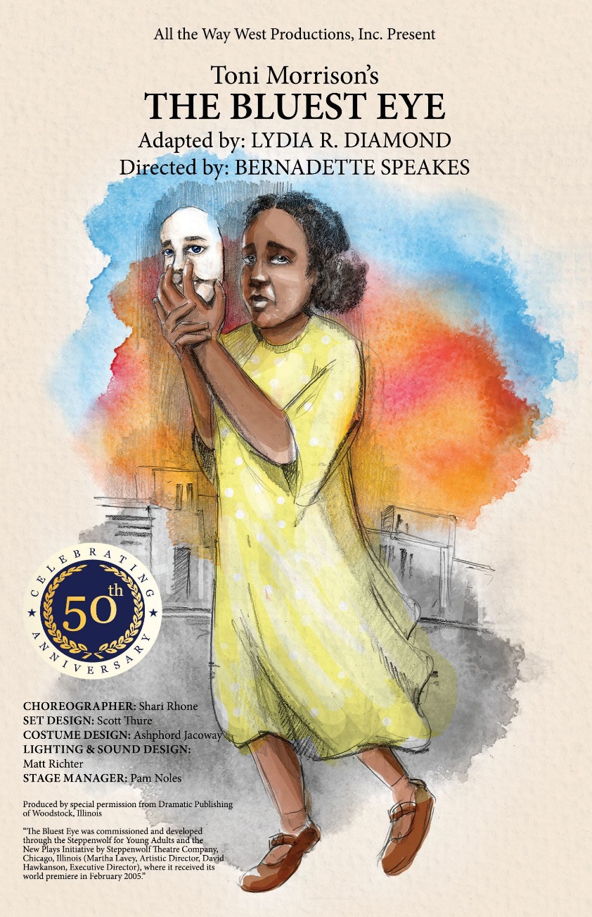
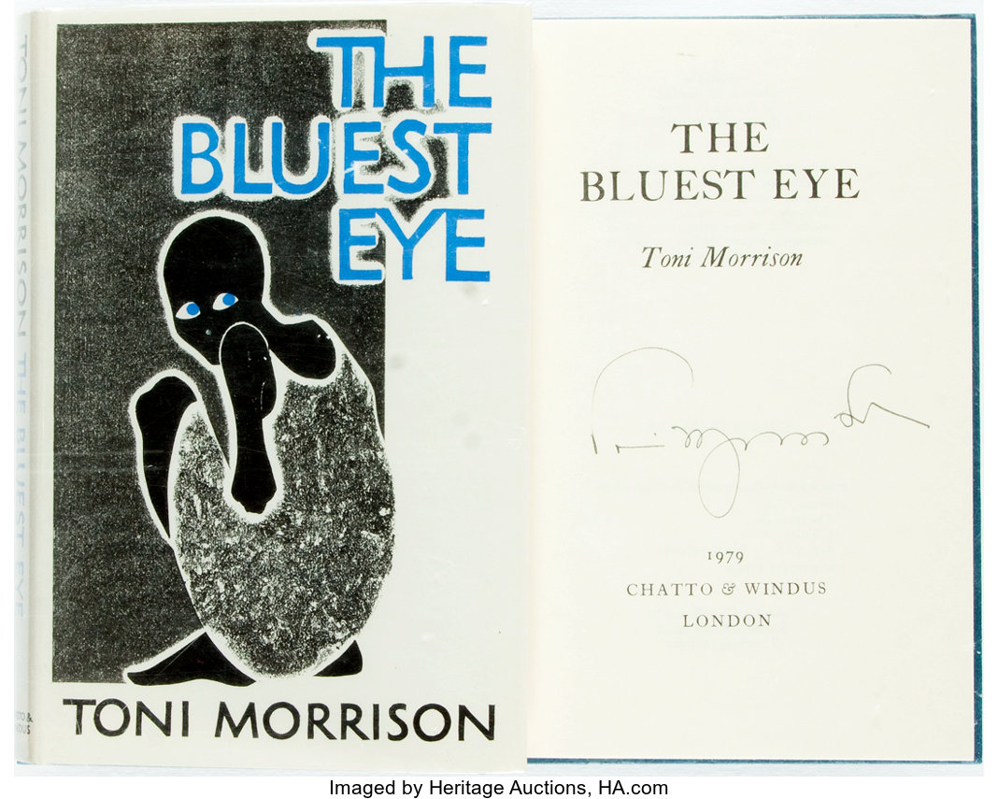

Slide 9
Classification of racial identifiers in fiction texts
Adjective: They are thin brown girls who have looked long at hollyhocks in the backyards of Meridian, Mobile, Aiken, and Baton Rouge; They sat in little rows on street curbs, crowded into pews at church, taking space from the nice, neat, colored children.
Noun: Lord. Have mercy. That dirty nigger; Well, that old crazy nigger she married up with didn’t help her head none.

Slide 10
Translation techniques used for the publicistic texts
Equivalent translation:
Black pastors: Ahmaud Arbery case highlights historical community role (USA Today, 2021, December 7) – Темношкірі пастори: Справа Ахмада Оберрі підкреслила важливу роль існування історичної спільноти (переклад Г. Вернидуб).
The Pillars of African American History: Ibi Zoboi’s Kwanzaa Picture Book (The New York Times, 2021, December 10) – Стовпи афроамериканської історії: Кванзійська фотокнига Ібі Зобої (переклад Г. Вернидуб).

Slide 11
Translation techniques used for the publicistic texts
Adding:
“Mayoral races could be huge milestones for Asian Americans” (Independent, 2018, March 22) - «Вибори на пост мера можуть стати значною віхою для американців азійського походження» (переклад Г. Вернидуб).
“Are Arab Americans people of color? Mayor vote raises issue” (Independent, 2018, March 22)” – Невже американці арабського походження також відносяться до кольорового населення? Питання нагального значення під час виборів на посаду мера (переклад Г. Вернидуб).

Slide 12
Translation techniques used for the fiction texts
Equivalent translation:
Dry-mouthed with excitement and apprehension, he went to the colored side of the counter to buy his ticket – В його горлі пересохло від захоплення та остраху, доки він підходив барної стійки для кольорових за білетом;
Junior used to long to play with the black boys – Молодший звик довго гратися з темношкірими хлопчиками (переклад Г. Вернидуб).

Slide 13
Practical recommendations for students’ preparation
work with the political and social agenda, make brief analysis of the main events;
detect preliminary racially marked words in texts and search for its equivalents or possible equivalents in dictionaries;
take a short history course focused on the emergence of the multicultural American society;
find translation analogies for rendering the same racially marked words in different contexts.

Slide 14
Thank you for attention!

